Slide 1
Machine Learning & Public Policy Lecture 2: Text Analysis
Professor Edward McFowland III
Information Systems and Decision Sciences
Carlson School of Managment
University of Minnesota
Heavily adapted from Panos Adamopoulos
Notes:
ML helps structured unstructured data. We saw images yesterday, we can also use text.
LDA
Word to Vec
Twitter Data
Google Trends

Slide 2


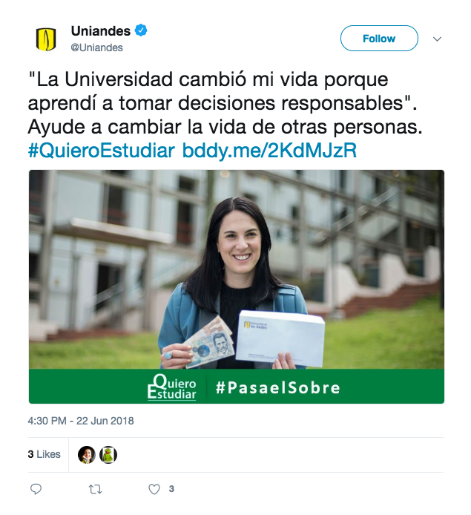
User-Generated Content
Reviews Are a Key Element of e-Commerce
Notes:
Think of all the user generated content we have at our disposal
From user reviews or articles, to tweets and facebook posts
We tweet about foods we like and don’t like. Companies we like and don’t
We have huge repositories of text, in which we can discover themes
A key element of ecommerce are reviews, which are predominately textual
Websites are just text with markup language
But also policy: Survey response, Google/Twitter Flu, discussion forums, summarize congressional bills, company, webites
What are some examples of text resources and what can they be used for in policy contexts?

Slide 3
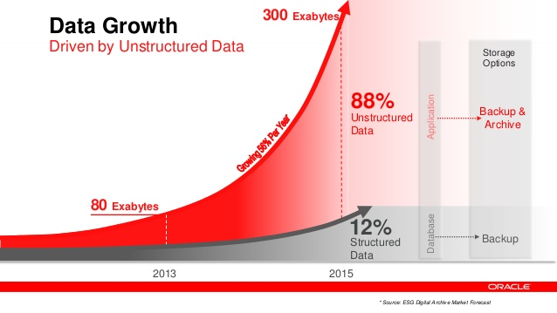

Slide 4
Dealing with Text
Data are represented in ways natural to problems from which they were derived
Vast amount of text..
If we want to apply the many data mining tools that we have at our disposal, we must
either engineer the data representation to match the tools (representation engineering), or
build new tools to match the data
Notes:
[read the following]
Each webpage is just marked-up text. When people communicate with each other on the Internet it is usually via text. Indeed, the thrust of Web 2.0 was about Internet sites allowing users to interact with one another as a community, and to generate much added content of a site. This user-generated content and interaction usually takes the form of text.
It generally is simpler to first try to engineer the data to match existing tools, since they are well understood and numerous.

Slide 5
Why Text is Difficult
Text is “unstructured”
Linguistic structure is intended for human communication and not computers
Word order matters sometimes
Text can be dirty
People write ungrammatically, misspell words, abbreviate unpredictably, and punctuate randomly
synonyms, homograms, abbreviations, etc.
Context matters
Notes:
[ask them why is text difficult to model and use]
Let’s see how to use text an properly represent it

Slide 6
Text Representation
Goal: Take a set of documents -each of which is a relatively free-form sequence of words- and turn it into our familiar feature-vector form
A collection of documents is called a corpus
A document is composed of individual tokens or terms
Each document is one instance
but we don’t know in advance what the features will be
Notes:
Goal and terminology

Slide 7
Text Representation
Bag of Words (BOW)

Slide 8
“Bag of Words”
Treat every document as just a collection of individual words
Ignore grammar, word order, sentence structure, and (usually) punctuation
Treat every word in a document as a potentially important keyword of the document
What will be a feature’s value in a given document?
Each document is represented by a one (if the token is present in the document) or a zero (the token is not present in the document)
Straightforward representation
Inexpensive to generate
Tends to work well for many tasks
Notes:
[Sets and bags] a bag is a multiset, where members are allowed to appear more than once.
How would they do it?
Benefits?

Slide 9
Pre-processing of Text
The following steps should be performed:
The case should be normalized
every term is in lowercase
Words should be stemmed
suffixes are removed
E.g. noun plurals are transformed to singular forms
Stop-words should be removed
A stop-word is a very common word in English (or whatever language is being parsed)
Typical words such as the words the, and, of, and on are removed
Notes:
How exactly would they proceed?
What would be a better model?
[e.g. works, work, worked]

Slide 10
Normalized Term Frequency
Documents of various lengths
Words of different frequencies
Words should not be too common or too rare
Both upper and lower limit on the number (or fraction) of documents in which a word may occur
Feature selection is often employed
The raw term frequencies are normalized in some way,
such as by dividing each by the total number of words in the document
or the frequency of the specific term in the corpus
Notes:
How would you like to proceed?
What would you control for?

Slide 11
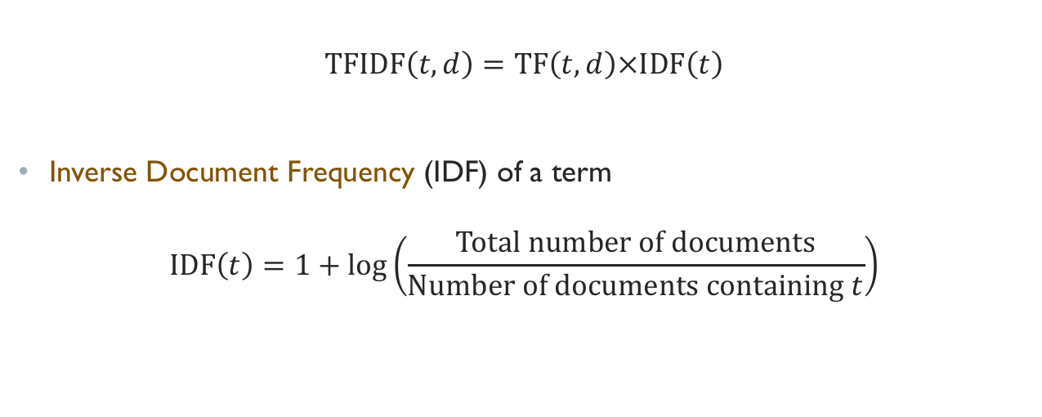
TF-IDF
$$\text{TFIDF}\left(t,d\right)=\text{TF}\left(t,d\right)×\text{IDF}\left(t\right)$$
Inverse Document Frequency (IDF) of a term
$$\text{IDF}\left(t\right)=1+\log\left(\frac{\text{Total} \text{number} \text{of} \text{documents}}{\text{Number} \text{of} \text{documents} \text{containing} t}\right)$$
Notes:
Note that the TFIDF value is specific to a single document (d) whereas IDF depends on the entire corpus.
If someone describes mining a text corpus using “bag of words” it just means they’re treating each word individually as a feature. Their values could be binary, term frequency, or TFIDF, with normalization or without. Data scientists develop intuitions about how best to attack a given text problem, but they’ll typically experiment with different representations to see which produces the best results.

Slide 12
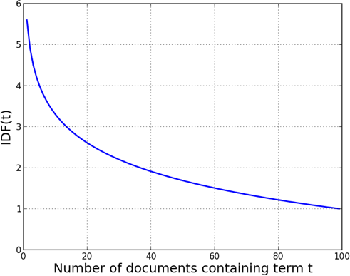
TF-IDF
Notes:
IDF for various numbers of documents containing a feature

Slide 13
Example: Jazz Musicians
16 prominent jazz musicians and excerpts of their biographies from Wikipedia
Nearly 2,000 features after stemming and stop-word removal!
Consider the sample phrase “Famous jazz saxophonist born in Kansas who played bebop and latin”
Notes:
First, basic stemming is applied.
→ Let’s see how each representation would work

Slide 14
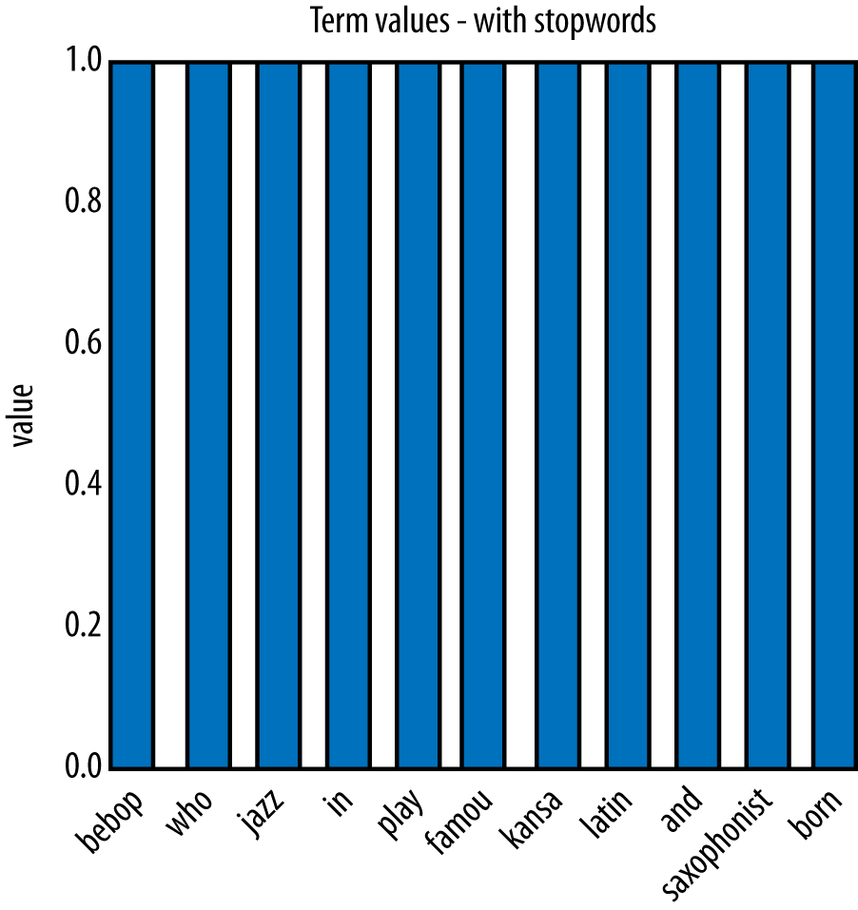
Example: Jazz Musicians
Notes:
This is the feature vector representation of this sample “document”
→ What would you do next?

Slide 15
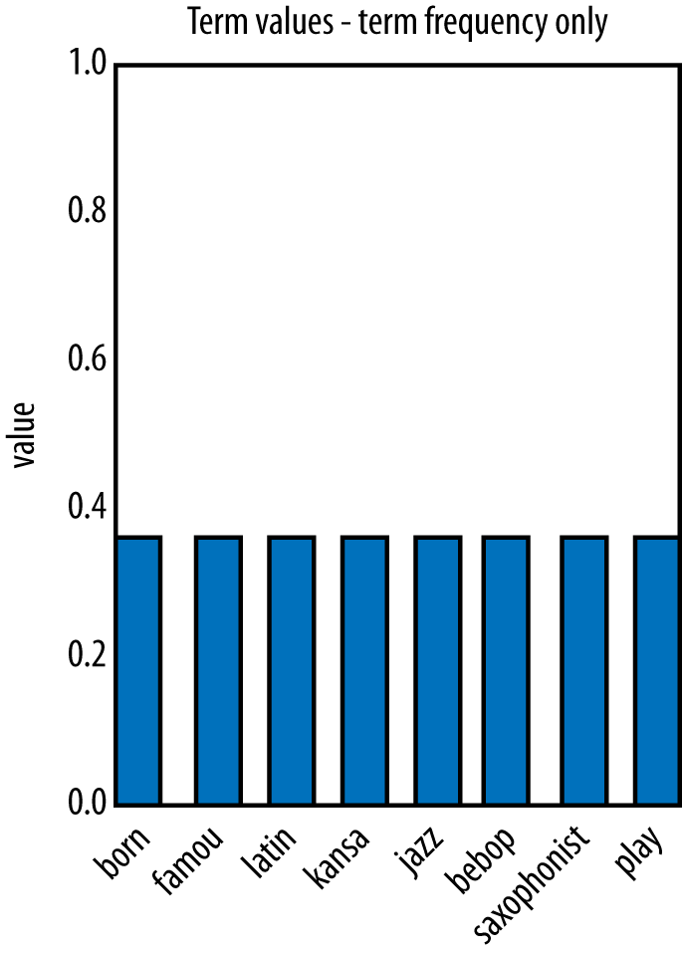
Example: Jazz Musicians
Notes:
Next, stopwords (in and and) are removed, and the words are normalized with respect to document length.
These values would typically be used as the Term Frequency (TF)
→ next?

Slide 16
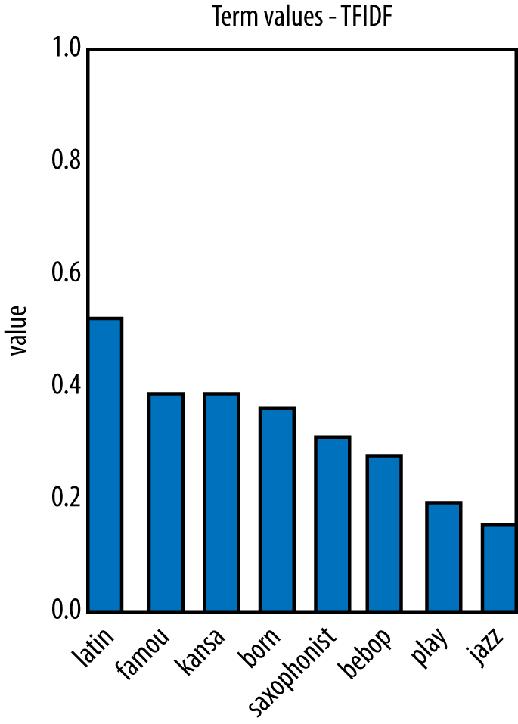
Example: Jazz Musicians
Notes:
we’ll generate the full TFIDF representation by multiplying each term’s TF value by its IDF value. As we said, this boosts words that are rare.
→ This representation can be useful in many ways

Slide 17
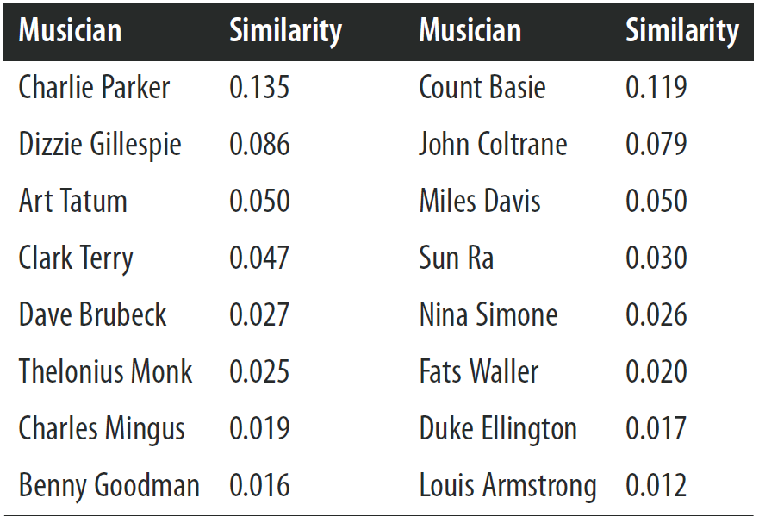
Example: Jazz Musicians
Notes:
Similarity of each musician’s text to the query ‘Famous jazz saxophonist born in Kansas who played bebop and latin,’ ordered by decreasing similarity.
[search engine]

Slide 18
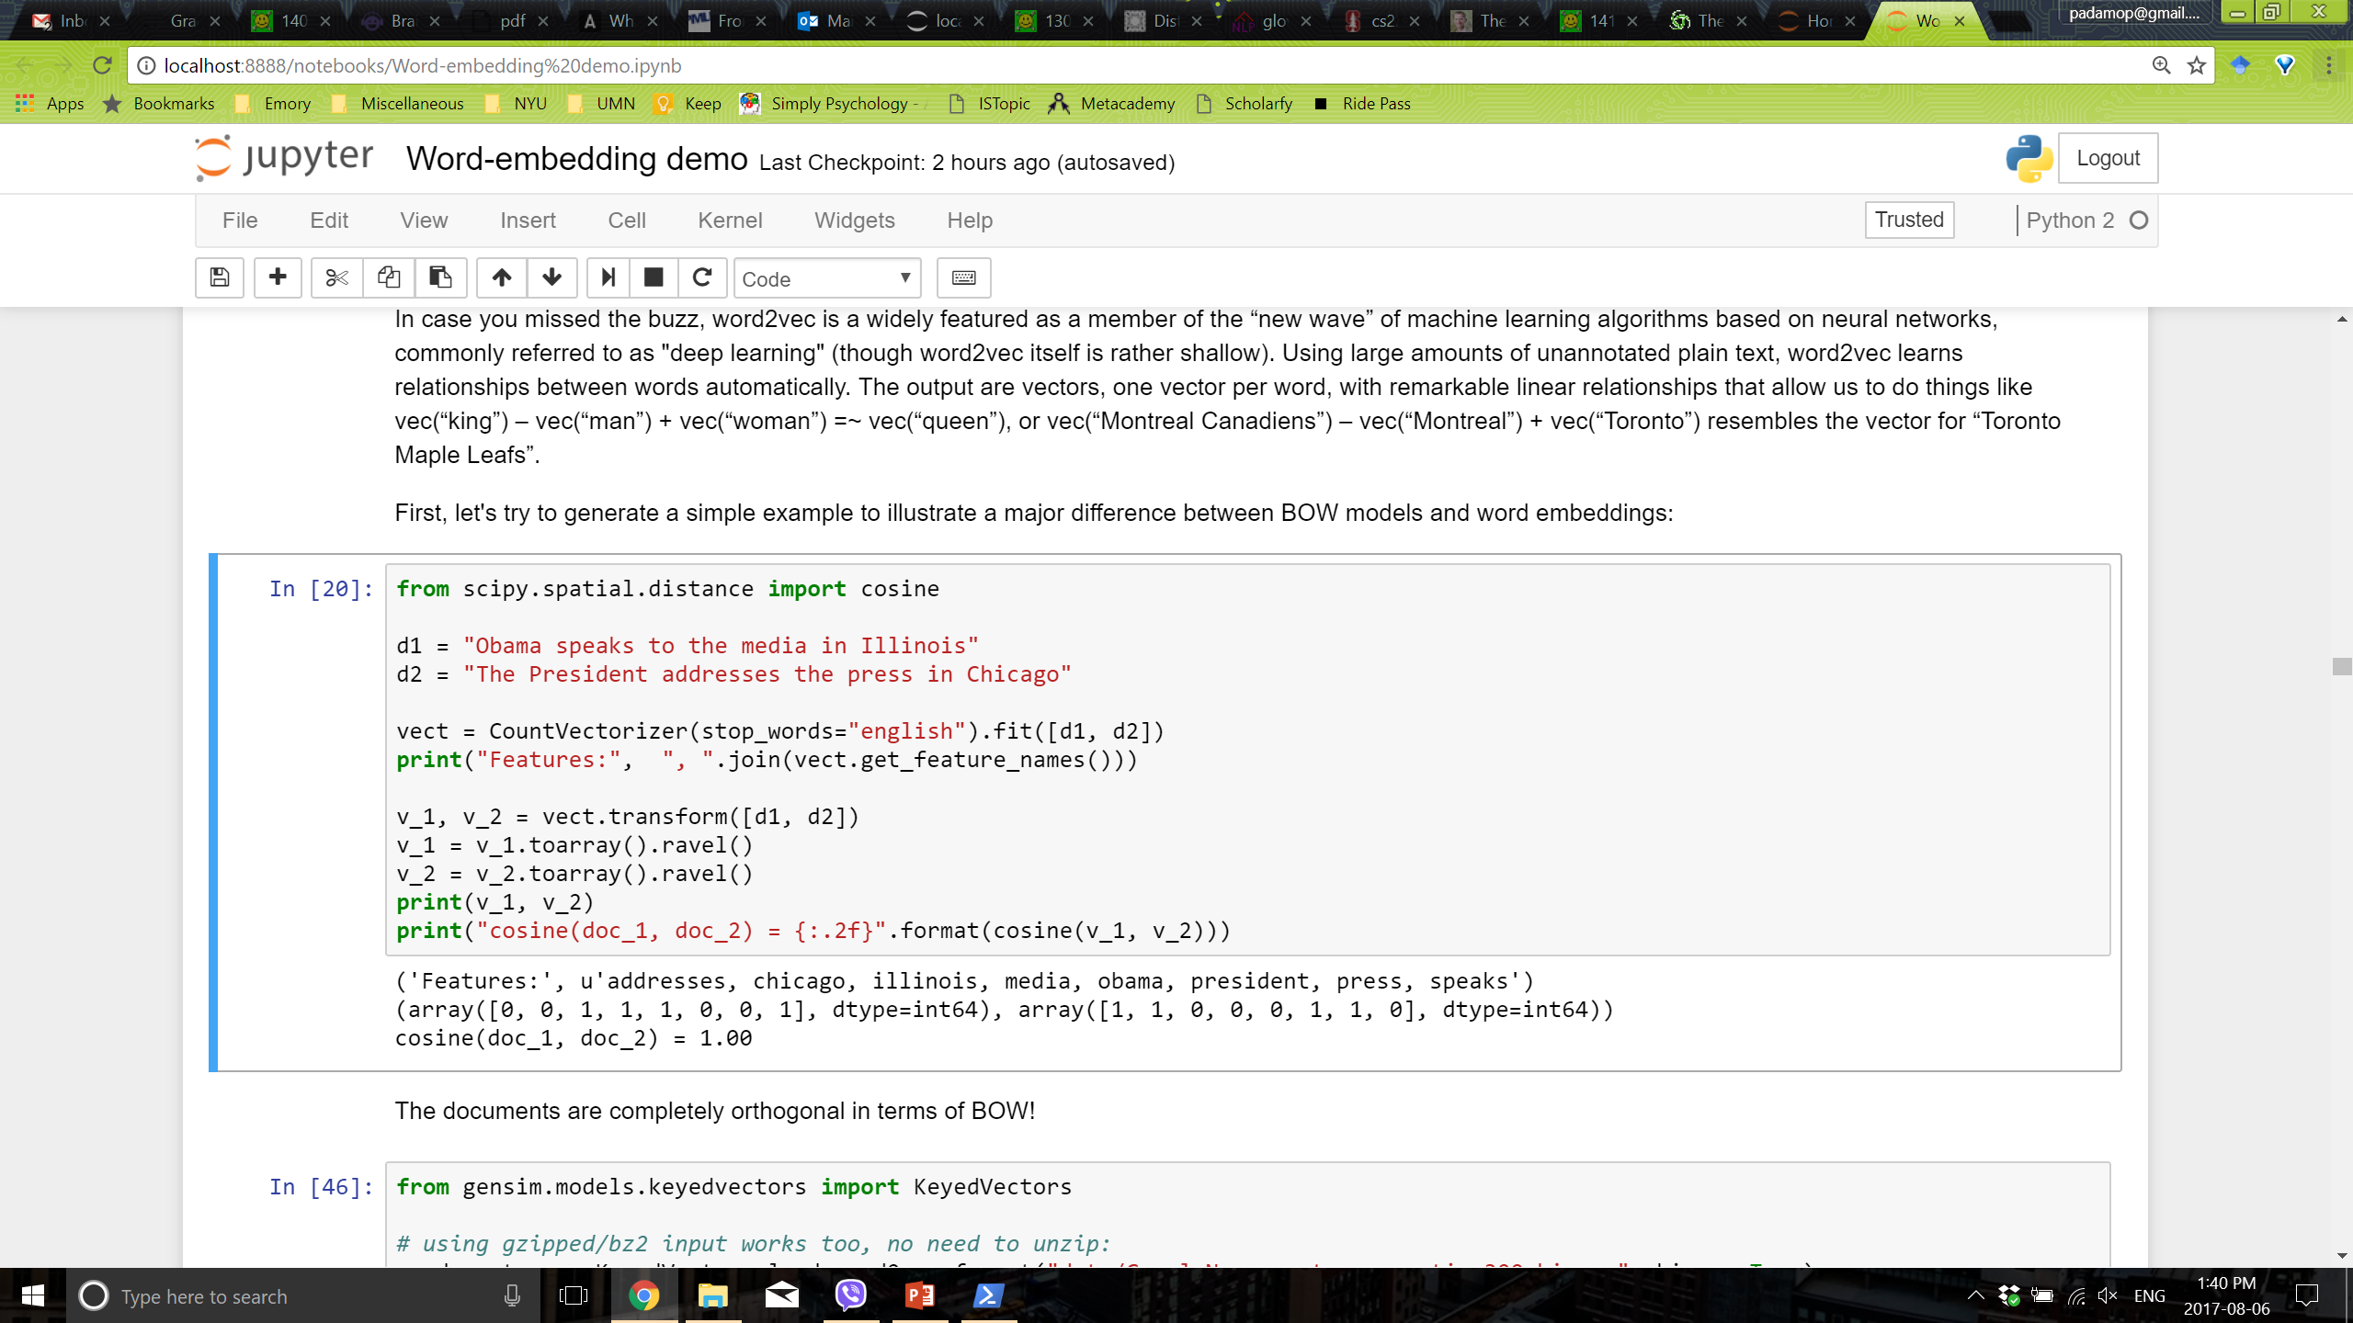
A Major Limitation of BOW

Slide 19
Text Representation
Beyond “Bag of Words”
Notes:
So what can we do better than simply treating each single word as a token

Slide 20
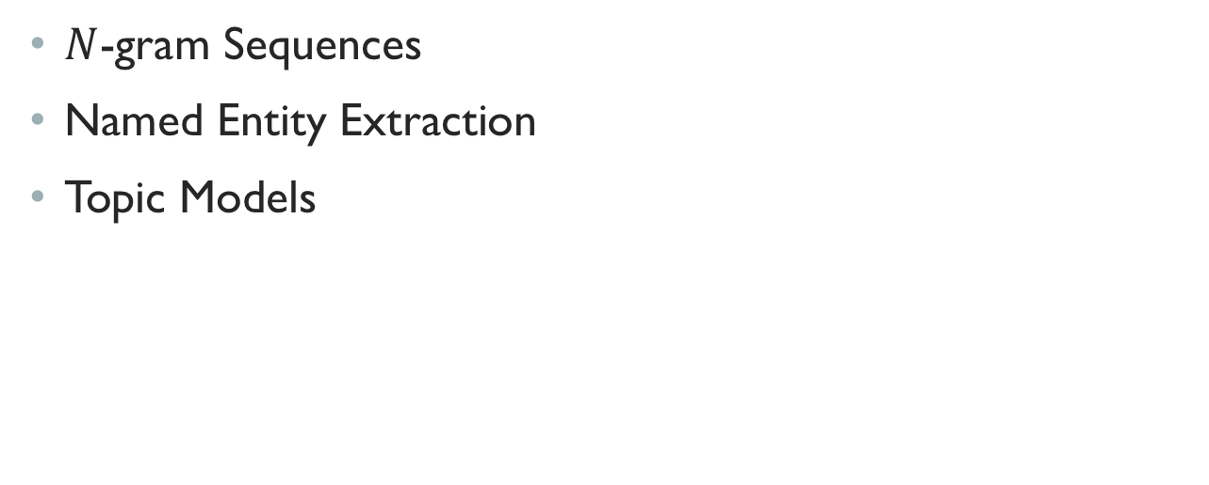
Beyond “Bag of Words”
$N$-gram Sequences
Named Entity Extraction
Topic Models
Notes:
→ n-gram

Slide 21
N-gram Sequences
In some cases, word order is important and you want to preserve some information about it in the representation
A next step up in complexity is to include sequences of adjacent words as terms
Adjacent pairs are commonly called bi-grams
Example: “The quick brown fox jumps”
it would be transformed into {quick, brown, fox, jumps, quick_brown, brown_fox, fox_jumps}
N-grams they greatly increase the size of the feature set

Slide 22
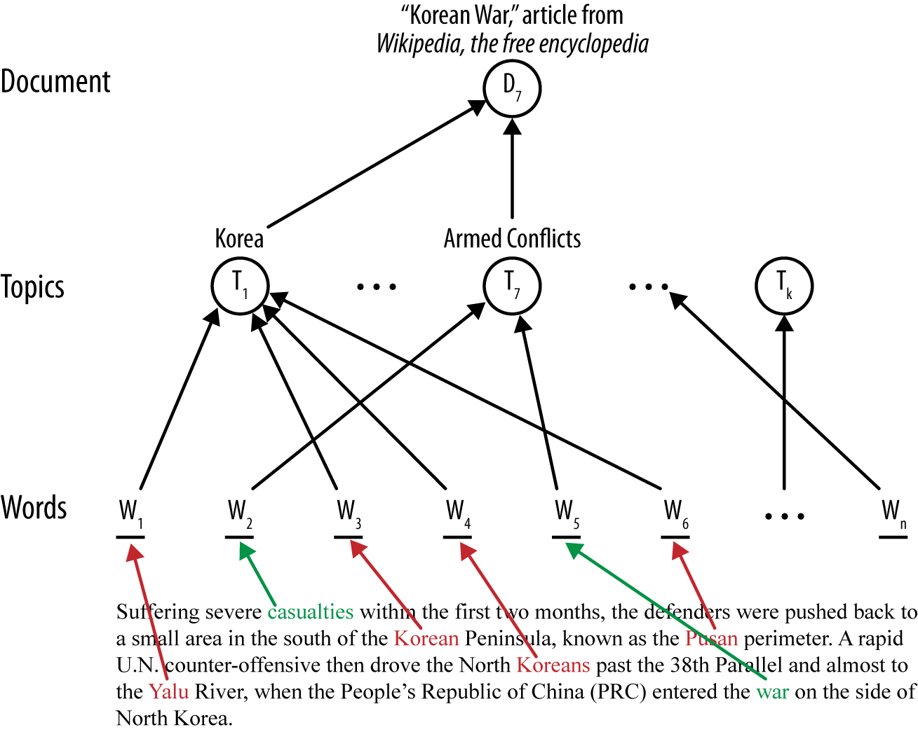
Topic Models
Notes:
Because of the complexity of language and documents, sometimes we want an additional layer between the document and the model. In the context of text we call this the topic layer
The main idea of a topic layer is first to model the set of topics in a corpus separately. As before, each document constitutes a sequence of words, but instead of the words being used directly by the final classifier, the words map to one or more topics. The topics also are learned from the data (often via unsupervised data mining). The final classifier is defined in terms of these intermediate topics rather than words.
One advantage is that in a search engine, for example, a query can use terms that do not exactly match the specific words of a document; if they map to the correct topic(s), the document will still be considered relevant to the search.
[extensions: ART, etc.]
LDA represents documents as mixtures of topics that spit out words with certain probabilities. It assumes that documents are produced in the following fashion: when writing each document, you Decide on the number of words N the document will have (say, according to a Poisson distribution).
Choose a topic mixture for the document (according to a Dirichlet distribution over a fixed set of K topics). For example, assuming that we have the two food and cute animal topics above, you might choose the document to consist of 1/3 food and 2/3 cute animals.
Generate each word in the document by:
....First picking a topic (according to the multinomial distribution that you sampled above; for example, you might pick the food topic with 1/3 probability and the cute animals topic with 2/3 probability).
....Then using the topic to generate the word itself (according to the topic's multinomial distribution). For instance, the food topic might output the word "broccoli" with 30% probability, "bananas" with 15% probability, and so on.
Learning So now suppose you have a set of documents. You've chosen some fixed number of K topics to discover, and want to use LDA to learn the topic representation of each document and the words associated to each topic. How do you do this? One way (known as collapsed Gibbs sampling*) is the following: Go through each document, and randomly assign each word in the document to one of the K topics.
Notice that this random assignment already gives you both topic representations of all the documents and word distributions of all the topics (albeit not very good ones).
So to improve on them, for each document d...
....Go through each word w in d...
........And for each topic t, compute two things: 1) p(topic t | document d) = the proportion of words in document d that are currently assigned to topic t, and 2) p(word w | topic t) = the proportion of assignments to topic t over all documents that come from this word w. Reassign w a new topic, where you choose topic t with probability p(topic t | document d) * p(word w | topic t) (according to our generative model, this is essentially the probability that topic t generated word w, so it makes sense that we resample the current word's topic with this probability). (Also, I'm glossing over a couple of things here, such as the use of priors/pseudocounts in these probabilities.)
........In other words, in this step, we're assuming that all topic assignments except for the current word in question are correct, and then updating the assignment of the current word using our model of how documents are generated.
After repeating the previous step a large number of times, you'll eventually reach a roughly steady state where your assignments are pretty good. So use these assignments to estimate the topic mixtures of each document (by counting the proportion of words assigned to each topic within that document) and the words associated to each topic (by counting the proportion of words assigned to each topic overall).

Slide 23
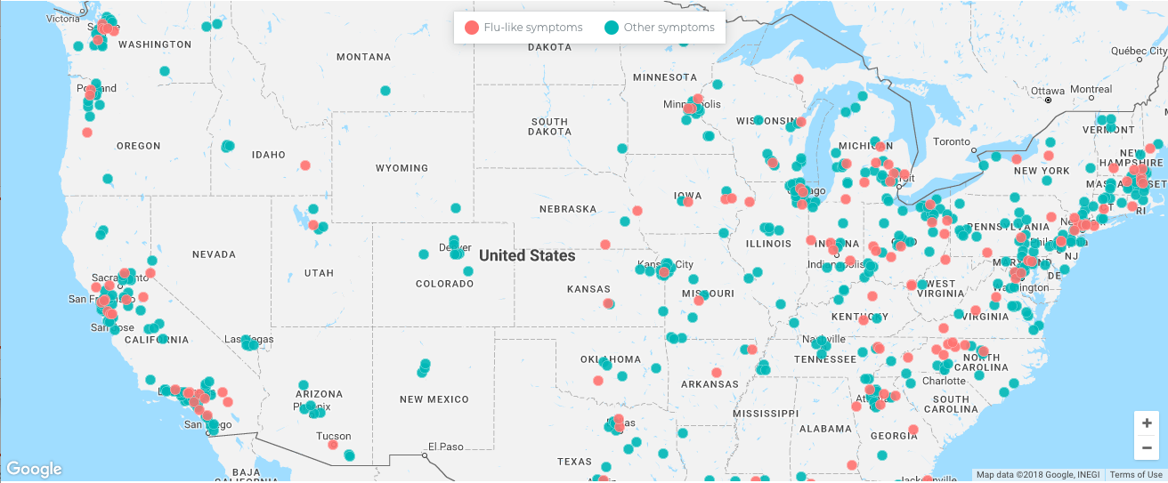
Topic Models
Given size of online repositories → manual organization is not practical
Our goal: To discover the hidden thematic structure with hierarchical probabilistic models called topic models
Traditional applications: browsing, searching, content-based recommender systems
Recent research:
Notes:
So much data, manual organization is not practical, so we want to use algorithm to come up with topics
So topic modeling is similar to our challenge of Gaussian mixture models.
There we were trying to capture the groups of data as well, but instead of text, it was prices of cameras or weights of students
The idea is that there is some underlying probabilistic data generating process
We observe data: words in a document and assume there is some probabilistic process that generates those words
Given the observations of the words, we want to go backwards and uncover the parameters of that process
In GMM what did we want to uncover? Proportions, means, and variances
In topic modeling, we want to uncover the hidden thematic structure
This is used
For Google (reading your e-mail) you are just a big document made up of themes
In recommendations when browsing the web, and determine what to see next
Search engines (forms key components) giving results
Content based recommender systems
Even though most applications are for textual data, can apply to many more contexts
Pictures once you create the picture as vector of values
(Lee, et al) Financial statements of companies and media stories to create proximity measures used to predict mergers and acquisitions
(Gong) Another interesting example, contextual factors that influence performance on paid search search advertising
Keyword is highly ambiguous -> who should advertise on it and what is expected click through
Ambiguity was measure based on how many topics seems to represent text about the keyword

Slide 24
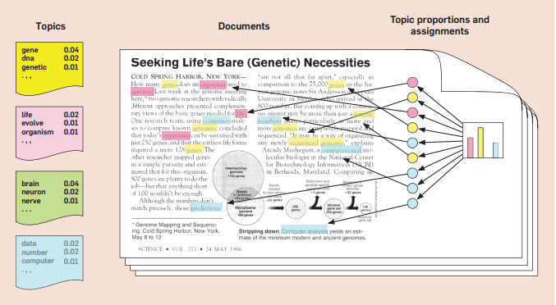
Latent Dirichlet Allocation
Latent Dirichlet Allocation
Notes:
So that is the background, no we will discuss the algorithm used to discover this hidden themes or topics: LDA
Latent because we do not know up front what themes are, we do have to specify how many upfront (like k-means).
We don’t know groups, words belong to which topics/groups, and the distribution of topics over documents
Dirichlet is the name of probability distribution used to model the data, it is a generalization of multinomial.
A benoulli is a coin
Multinomial is 3 sided die
Dirchlete will produce for me a multinomial (generates for me a random dice)
Allocation is allocation each document across the topics.
Each words belongs to topics at different proportions (just like GMM)
Each document is composed of different topics at different proportions (again like GMM)

Slide 25
Latent Dirichlet Allocation
Imagine a generative probabilistic process for this document
Notes:
Hopefully you have read the article, this is where this example comes from.
It assumes some underlying probabilistic process to generate docs.
For a document, we pull a topic at random based on the assumed topic distribution (just like we pulled groups at random with GMM)
We then pull a word from that topic based on the distribution over words, just like we pulled a height based on the Gaussian distribution
Now this is not the way we think of writing documents, but this is the way you can imagine one could have been generated.
No different conceptually to of Gaussian mixture model.
Underlying data distribution was normal and we need to estimate the parameters.
How did we come up with that with the combination of Gaussians, how do I figure out the mean, and var
Make a guess about what the means and variances and then see how likely the data is given it.
The data generating process is more complex than GMM because there are many documents made up of many words representing topics, but GMM gives you a foundation from which to think about this.

Slide 26
Imagine a generative probabilistic process for this document
Lets say we have 100 distributions of words, ie 100 topics
Some have words about genetics with high probability
Some have words about computation with high probability
Each document is a random mixture of these 100 topics
Each word is a draw from one of these topics
Notes:
The structure assume number of topics: 100.
Imagine a matrix that where each row is a word and the columns are the k topics
A topic is a prob distribution over all the words. So the column is a topic. .007, 0.0013, etc.
Column 1 is about genetics (gene 0.04, dna 0.02, comp 0.000001, cake 0.0000000000000001).
So It is a w-sided die that a roll to generate a word. Most of the time I will get gene and dna, though I could get cake every billion times I roll
Every word belongs to every topic, can have low prob, but non zero.
A topic distribution is just this column. We don't know what topics are there and we have figure this out.
Each document is made up of topics. So I have another matrix here, where the rows are documents and the columns of topics.
And it's how much each document is made up of each topic.
But remember each topic is just a distribution over words. So I have a distribution over topics (or a distribution over distributions.)
We have 100 distributions. Dirchlet dist comes to play, because it is a distribution of distributions.

Slide 27
Choose a distribution over the distribution of words (aka topic)
For each word in the collection choose a topic and draw a word from the distribution
E.g. word ‘organism’ came from the pink topic
Repeat this process for every document
Notes:
3 theme in this article (genetics, computation, biology).
These themes are a distribution over topics.
Bar probability of this topic in this document.
So for a given document imagine a bar graph saying what percentage of the documents is from each topic.
The data generating process for a document is the same way we thought about heights in gender:
I choose a cluster at random then I choose people from that cluster.
Now for a document, I choose topic at random, then draw a word from that topic at random.
If a topic was (essentially) composed of only two topics at 3/4 1/4 rate, what proportion of words from each topic should I have?
Draw document 1 on the board then draw a blank version of document 1. Generate words and populate your document 1. Then say we want compute the parameters (fill in the rows of the matrix) such that the words the show up in my generated document show up (at the same rates) in the actual document.
We do this for all documents at the same time
Each document is assumed to be generated in this manner: What is one challenge or limitation of this that we didn’t face with GMM

Slide 28
In reality, we only observe the documents
We need to discover the underlying topic structure
What are the topics?
How are the documents divided according to these topics? – topic proportion
How likely is a given word associated with a given topic? – topic (to word) assignment
Notes:
So this is the assumed process by which a document is constructed
Again we don't know the topics proportions for each document or the word proportions for each topic, all we observe is the row text.
We are going to learn all these proportions and parameters simply from the text.
The same way we did for GMM
we learned the proportions
memberships, and means, variances just from observing prices of cameras or heights of people.
This just happens to be a much more complex scenario because we are now dealing with text.
So all we see are the words and we have to back out the parameters that best explains our data.
Discover the topics themselves given a fixed number of them
Proportions (the bar chart) for every doc
Topic to word assignment
These are hidden parameters which is why its called latent.

Slide 29
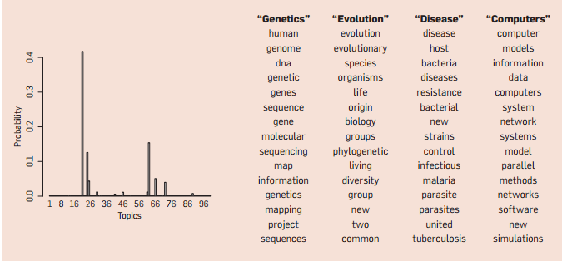
100 Topic Model to 17,000 Science Articles
Left – Topic proportions for a given article
Right – Top 15 most frequent words from the most frequent topics
Notes:
Blaze article, Left hand sign, for a given article membership in particular topic.
Belongs mostly to these 3-4 topics.
The other topics don't really explain the article. For most common topics across (or within) documents I can see the ope keywords for that topic. This is what the algorith gives you, we will have to define what these topics means (context)

Slide 30
Embedded (Vector) Representation
Words as dense numeric vectors
Semantics of words (vs. bag-of-words)
distances between words and phrases
New York
USA
Manhattan
Brooklyn
France
Paris
Camera
Restaurant
Book
Notes:
In order to implement this method, we use an efficient and state-of-the-art method based on deep-learning techniques (Le and Mikolov 2014; Mikolov et al. 2013b). In particular, instead of treating the individual words of user-generated texts as unique symbols (tokens) without meaning, as in common bag-of-words and bag-of-n-grams models, the employed method reflects semantic and syntactic similarities and differences among words and phrases by representing them as dense vectors, usually referred to as “neural embeddings”.
In essence, the continuous space representations are learned in an unsupervised fashion by trying to maximize the dot-product between the vectors of frequently occurring word-context pairs and minimize it for random word-context pairs (Levy and Goldberg 2014). After the training converges, words with similar meaning are mapped to a similar position in the latent space. We use a pre-trained open-source model that contains 300-dimensional vectors for 3 million words and phrases.
We should note that this method is general and applicable to texts of any length (e.g., sentences, paragraphs, documents) and does not require task-specific tuning.

Slide 31
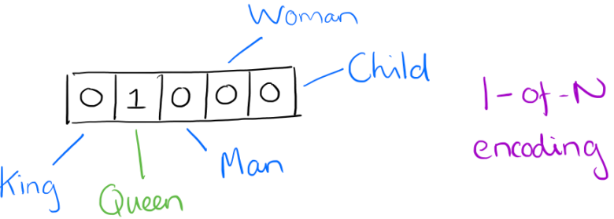
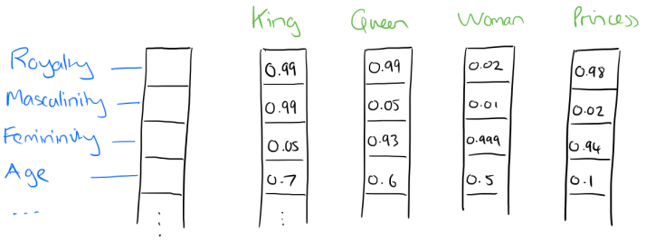
Representing the meaning of words
One-Hot
Distributed Representation
Notes:
Suppose our vocabulary has only five words: King, Queen, Man, Woman, and Child. We could encode the word ‘Queen’ as:
If I label the dimensions in a hypothetical word vector (there are no such pre-assigned labels in the algorithm of course), it might look a bit like this:

Slide 32
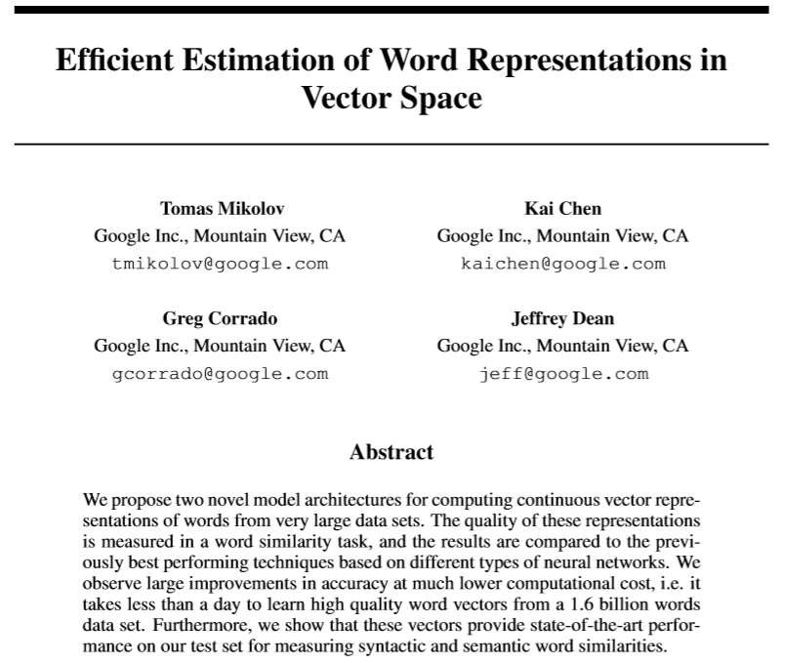
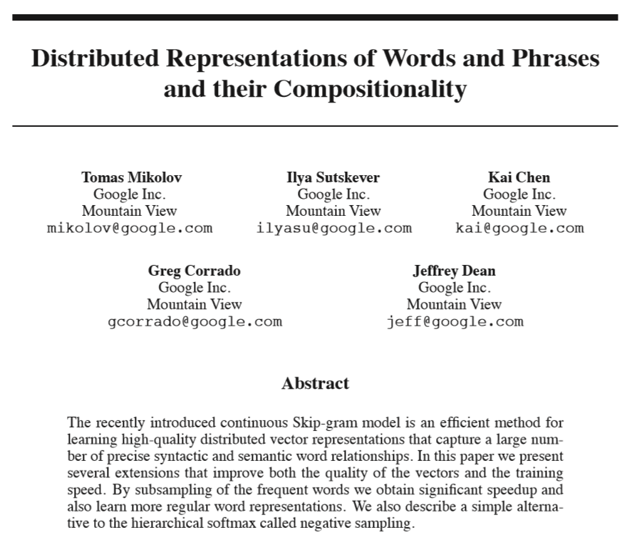
Word2Vec – Embedding Text
Two original papers published in association with word2vec by Mikolov et al. (2013)

Slide 33
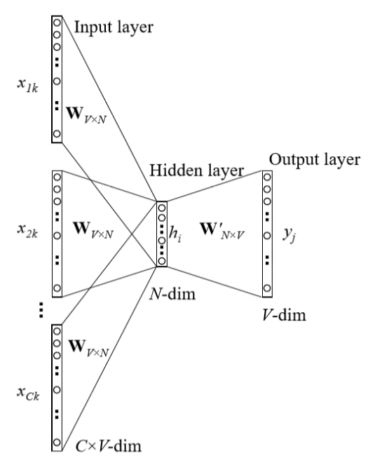
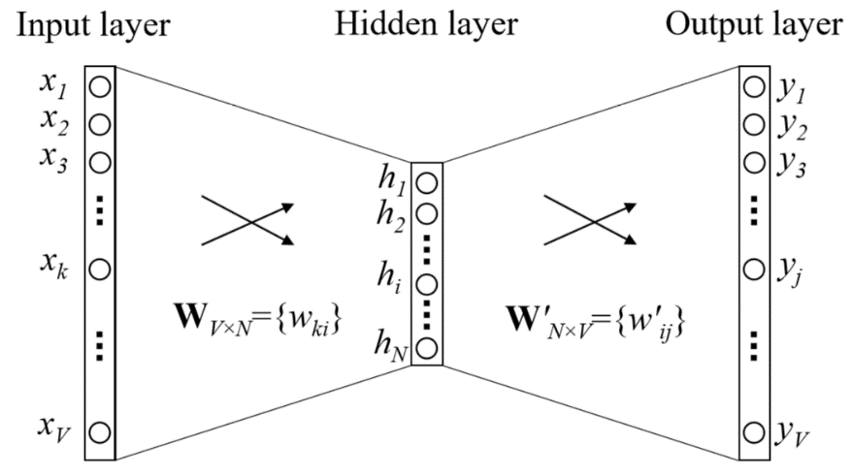
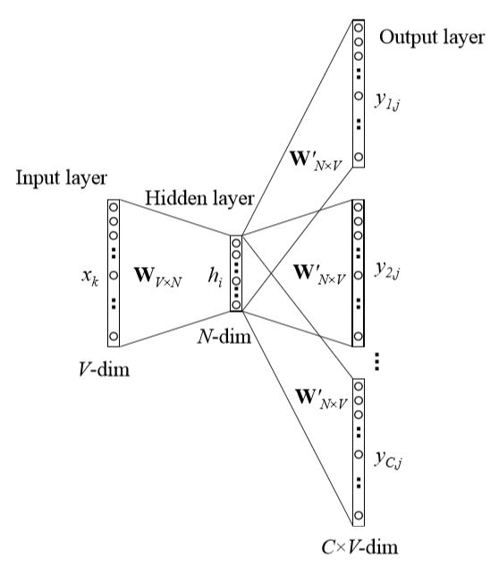
Word2vec
Use Neural Network
To embed words into
Dimension N (100-700)
CBOW
Skip-gram
word2vec model architecture
Notes:
Two algorithms:
Skip-grams (SG) Predict context words given target (position independent)
Continuous Bag of Words (CBOW) Predict target word from bag-of-words context
We call this architecture a bag-of-words model as the order of words in the history does not influence the projection.

Slide 34
Word2vec
Use Neural Network to embed words into smaller dimension (N = 100-700)
word2vec model architecture
Notes:
Two algorithms:
Skip-grams (SG) Predict context words given target (position independent)
Continuous Bag of Words (CBOW) Predict target word from bag-of-words context
We call this architecture a bag-of-words model as the order of words in the history does not influence the projection.

Slide 35
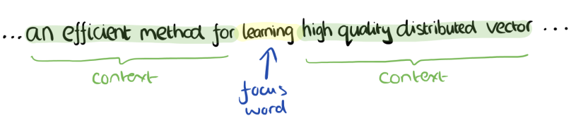
Contextual Representation
Word is represented by context in use:
I eat an apple every day.
I eat an orange every day.
I like driving my car to work.
Notes:
Mikolov et al. weren’t the first to use continuous vector representations of words, but they did show how to reduce the computational complexity of learning such representations – making it practical to learn high dimensional word vectors on a large amount of data. For example, “We have used a Google News corpus for training the word vectors. This corpus contains about 6B tokens. We have restricted the vocabulary size to the 1 million most frequent words…”

Slide 36
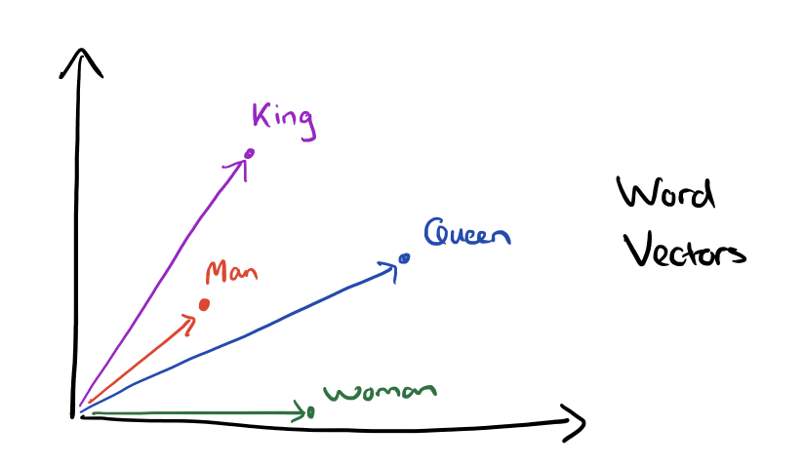
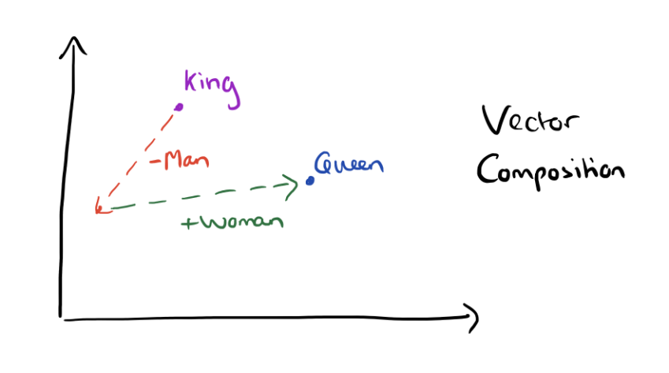
Word2vec

Slide 37
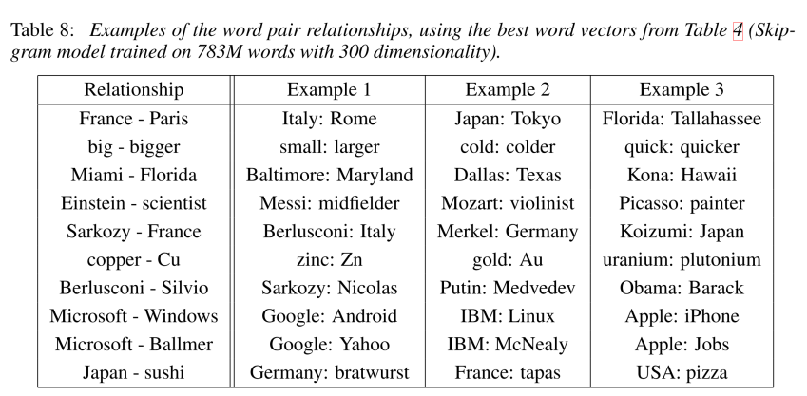
Word2vec

Slide 38
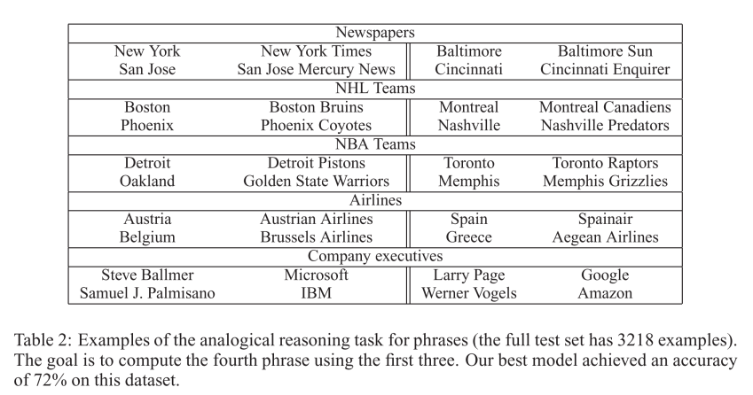
Word2vec

Slide 39
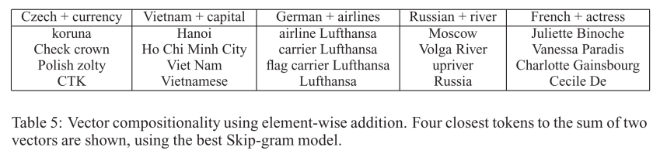
Word2vec

Slide 40
Word2vec
Unsupervised ML:
Berlin is to Germany as Paris is to …?
king – man + woman = ?
“dinner cereal breakfast lunch”, which word doesn’t fit?

Slide 41
Prediction For Policy
Aiding in Public Health

Slide 42
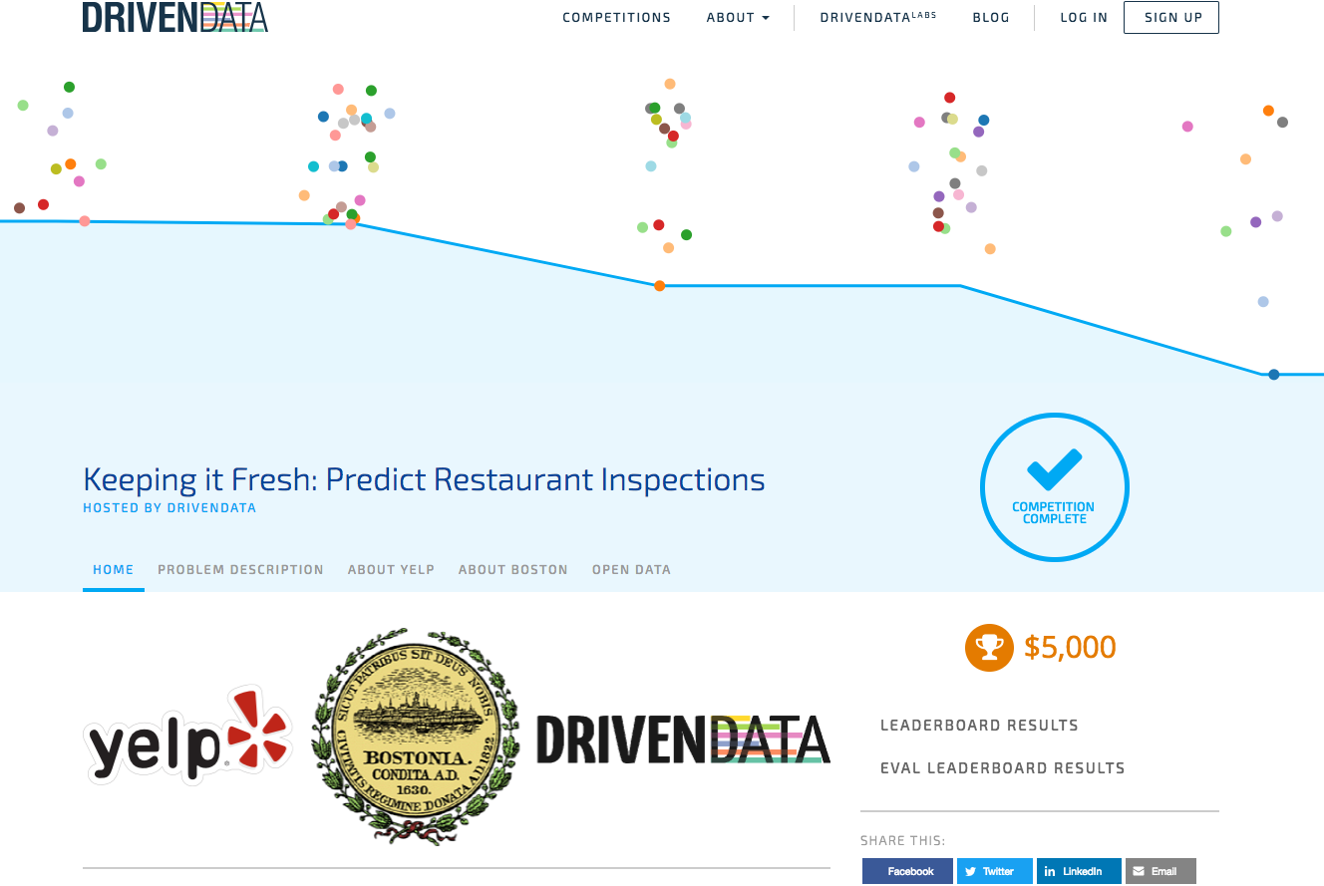
Aiding in Public Health
Notes:
So what data does Yelp offer that goes beyond what Policy Makers currently have at their disposal?

Slide 43
Predicting Restaurant Sanitation
Outbreaks of illness commonly come from food prepared by restaurants
Estimated 75% of the outbreaks in US came from food prepared by caterers, delis, and restaurants.
Health inspectors are a constrained resource but inspections are random
Yelp collects rich data about customers’ experiences at restaurants
Predominately through ratings and free text reviews
Can Yelp’s data make the process of sending Health Inspectors to restaurants more efficient?
Kang et al. found using Yelp’s reviews data and past health inspection records can predict future inspection scores for restaurants 82% of the time.
Meja et al. shows that Yelp’s reviews data can identify cases of hygiene violations in restaurants, even after the restaurant has been inspected and certified.
Notes:
This is a really important problem
According to the Centers for Disease Control, more than 48 million Americans per year become sick from food, and an estimated 75% of the outbreaks came from food prepared by caterers, delis, and restaurants.
Cities only have a limited number of health inspectors, quite often their time is wasted on spot checks at clean, rule-abiding restaurants. This also means that sometimes restaurants with poor health and safety records are discovered too late.
Yelp connects people with local businesses and along the way they’ve gathered rich data about customers’ experiences at those businesses via reviews, tips, check-ins and business attributes.
In particular, could we use Yelp’s reviews and business information to make the process of sending Health Inspectors to restaurants more efficient?
A research study by Prof. Michael Luca from Harvard Business School and Prof. Yejin Choi from Stony Brook University and their graduate students found that a machine learnt model built using Yelp’s reviews data and past health inspection records is able to successfully predict future inspection scores for restaurants 82% of the time.
A research study by Prof Jorge Meja at Indian University and others, argue that there exist information asymmetry, which lead to moral hazards in this context
Restaurants who have acquired the highest hygiene certification can gradually discontinue their efforts to maintain their hygiene standards, given the knowledge that the next inspection cycle is more than a year away
Regulating agency therefore is one of information asymmetry, as they do not know which will do this
Using a crowd-based “information system” created through the appropriate extraction of information from online reviews, they show that incidents of moral hazard can be identified, alleviating the asymmetry and thereby helping policy makers and regulators in their decision making.
https://engineeringblog.yelp.com/2015/04/data-science-contest-keeping-it-fresh-predict-restaurant-health-scores.html
http://mankad-research.hosting.cornell.edu/Hygiene_Circulation.pdf

Slide 44
Predicting Restaurant Sanitation
Target variable: binary
whether the restaurant will have a (class minor, major, or severe) violation on a given inspection date
Prediction: class probability estimation
The probability that a restaurant will have a given violation on the inspection date
Targeting: target restaurants that are more likely to have (more extreme) violations
Features: review, reviewer, and restaurant characteristics.

Slide 45
Combining Evidence Probabilistically
The unstructured nature of text makes things difficult
It is all but certain we will not have the exact same review repeated
We will consider the different pieces of evidence separately, and then combine the evidence
“Evidence” here represents the marginal correlation of the use of a word, in a review, with the probability of a violation

Slide 46
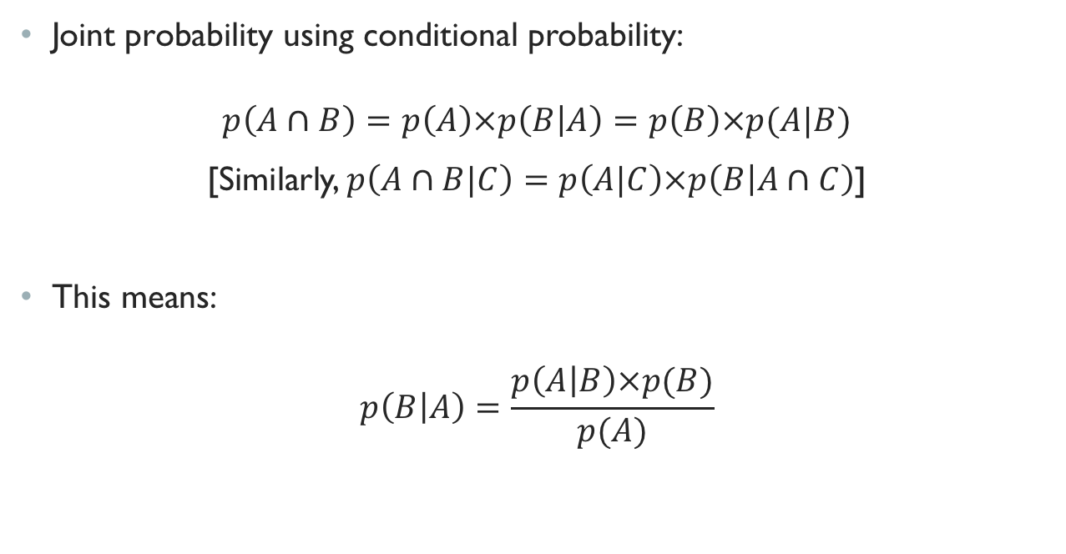
Bayes’ Rule
Joint probability using conditional probability:
$$p\left(A∩B\right)=p\left(A\right)×p\left(B | A\right)=p\left(B\right)×p(A|B)$$
[Similarly, $p\left(A∩B|C\right)=p\left(A|C\right)×p\left(B | A∩C\right)$]
This means:
$$p\left(B | A\right)=\frac{p\left(A | B\right)×p(B)}{p(A)}$$
Notes:
Who remembers Bayes rule?
What does it mean?

Slide 47
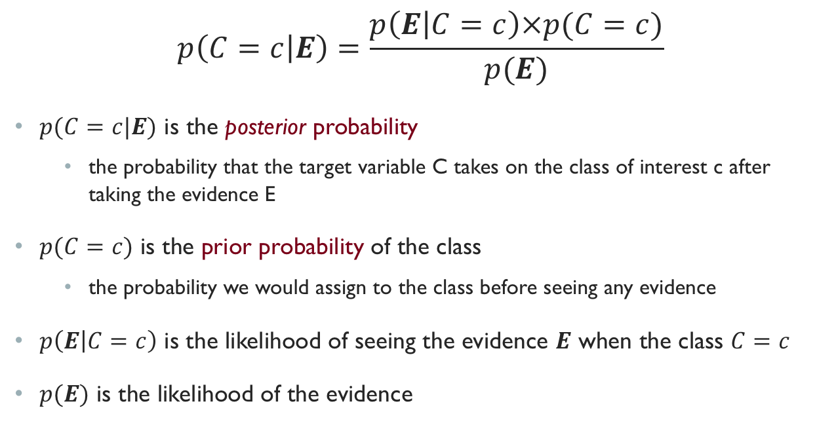
Bayes Rule for Classification
$$p\left(C=c | E\right)=\frac{p\left(E | C=c\right)×p(C=c)}{p(E)}$$
$p(C=c|E)$ is the posterior probability
the probability that the target variable C takes on the class of interest c after taking the evidence E
$p(C=c)$ is the prior probability of the class
the probability we would assign to the class before seeing any evidence
$p\left(E | C=c\right)$ is the likelihood of seeing the evidence $E$ when the class $C=c$
$p(E)$ is the likelihood of the evidence
E: Full Text of Review
C: Health Violation

Slide 48
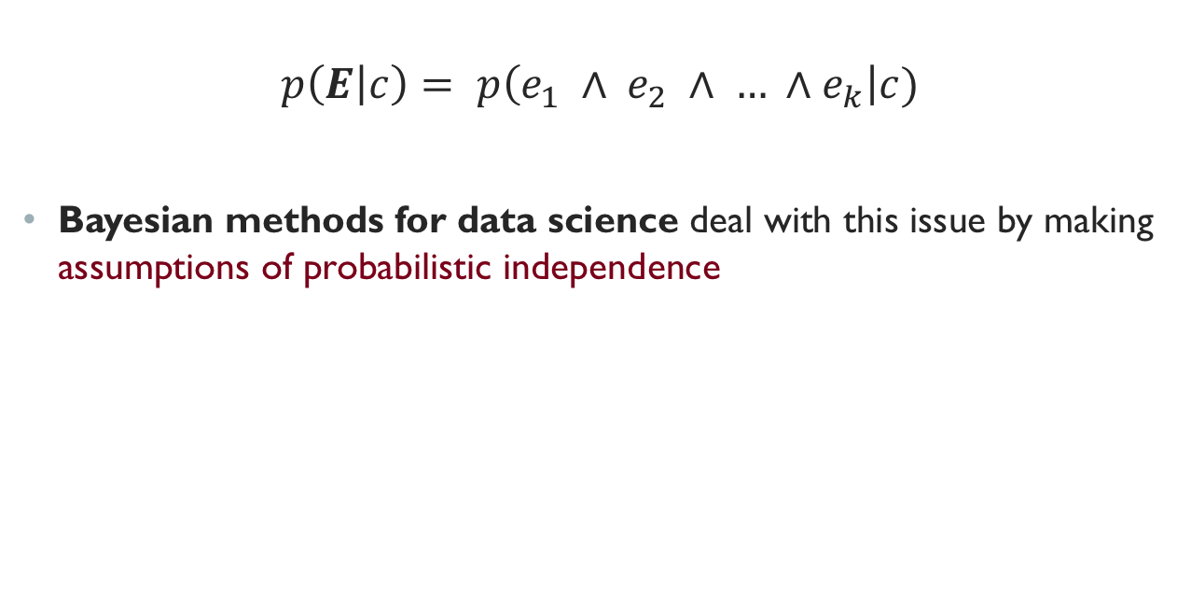
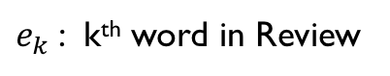
Bayes Rule for Classification
$$p\left(E | c\right)= p\left(e_{1} ∧ e_{2} ∧ … ∧e_{k}\right|c)$$
Bayesian methods for data science deal with this issue by making assumptions of probabilistic independence
$e_{k}$: k^{th} word in Review

Slide 49
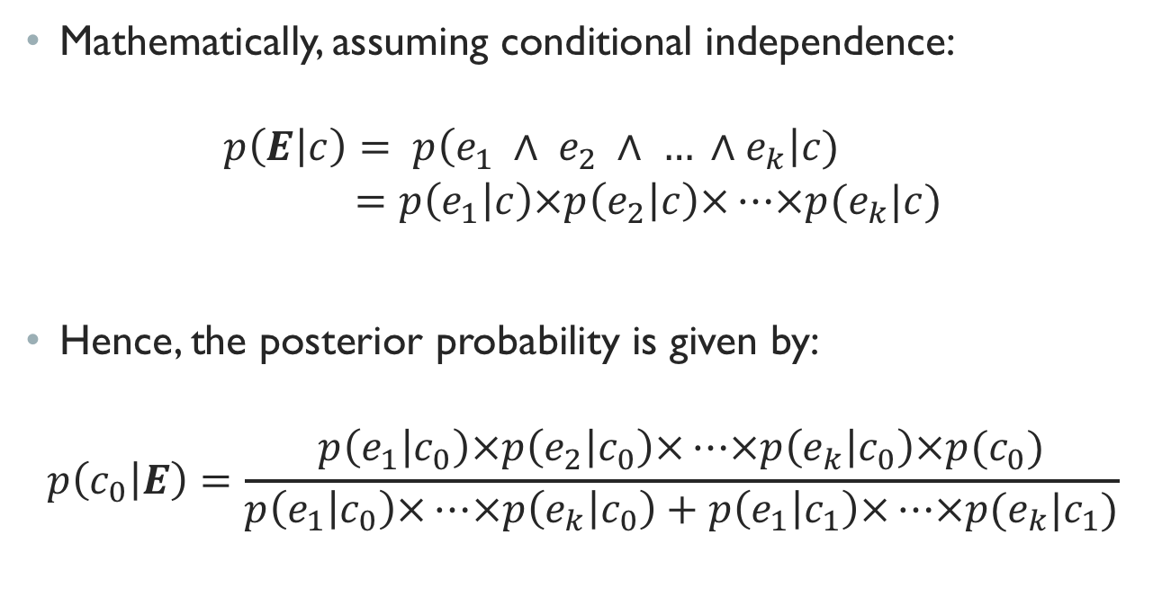
Conditional Independence and Naïve Bayes
Mathematically, assuming conditional independence:
$$p\left(E | c\right)= p\left(e_{1} ∧ e_{2} ∧ … ∧e_{k}\right|c) \\ =p\left(e_{1} | c\right)×p\left(e_{2} | c\right)×…×p(e_{k}|c)$$
Hence, the posterior probability is given by:
$$p\left(c_{0} | E\right)=\frac{p\left(e_{1} | c_{0}\right)×p\left(e_{2} | c_{0}\right)×…×p\left(e_{k} | c_{0}\right)×p(c_{0})}{p\left(e_{1} | c_{0}\right)×…×p\left(e_{k} | c_{0}\right)+p\left(e_{1} | c_{1}\right)×…×p(e_{k}|c_{1})}$$

Slide 50
Advantages and Disadvantages of Naïve Bayes
Very simple classifier
Efficient in terms of both storage space and computation time
Performs well in many real-world applications
Non-accurate class probability estimation
Incremental learner

